Slide 1

Career College- Management Dashboard
Data Analytics Bootcamp, UofT
March 28, 2020

Slide 2




Project Team
Shruti Raj,
Research Specialist at Renaissance Computing Institute
Key Skills: Python,
Pandas, SQL, HTML, ML
LinkedIn Profile
GitHub Profile
Lovjeet Sawhney, PMP®
Project Manager - at Academy of Learning College
Key Skills: Python, Pandas, SQL, HTML, Tableau
LinkedIn Profile
GitHub Profile

Slide 3
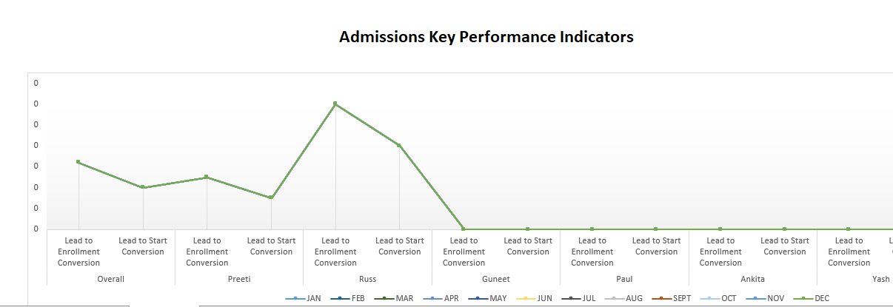
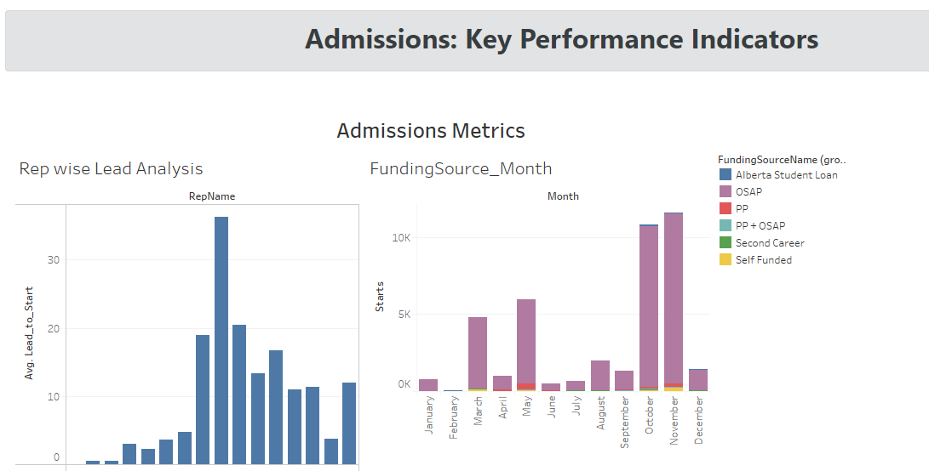
Project Objective
Sep 2019: Excel Dashboard
To create a management dashboard for monitoring performance of a career college.
The dashboard will visualize key parameters for Admissions, Student Operations and Financial metrics to indicate the overall health of the business.
Analytical tool will be used to collect data from multiple sources/systems and machine learning will be applied to predict student dropouts with a goal to improve student retention rate.
Mar 2020: Web Dashboard

Slide 4
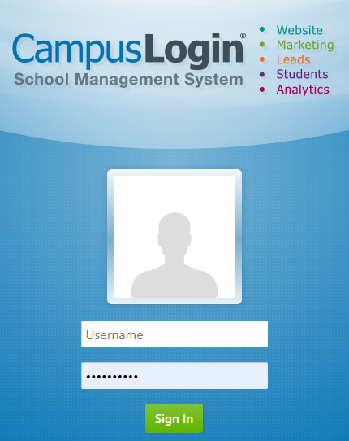


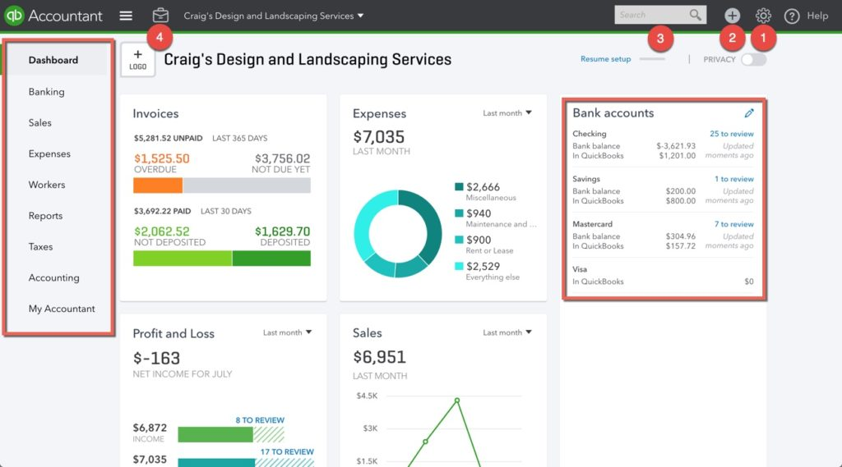
Data Sources: Jan – Dec 2019
40+ csv Files
Flash Report: 12 csv
Masters: 1 csv
Student Attendance: 12 csv
Student Completion Summary: 12 csv
Accounts Payable: 1 csv
Accounts Receivable: 2 csv

Slide 5
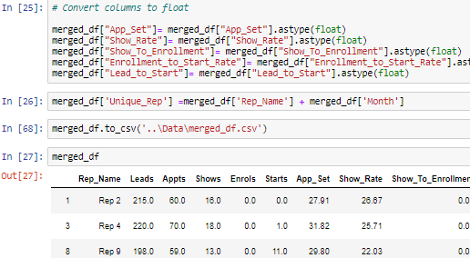
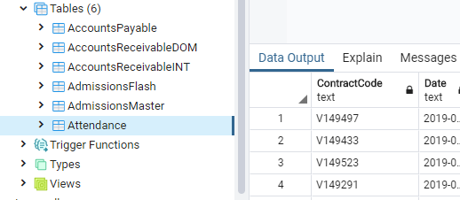
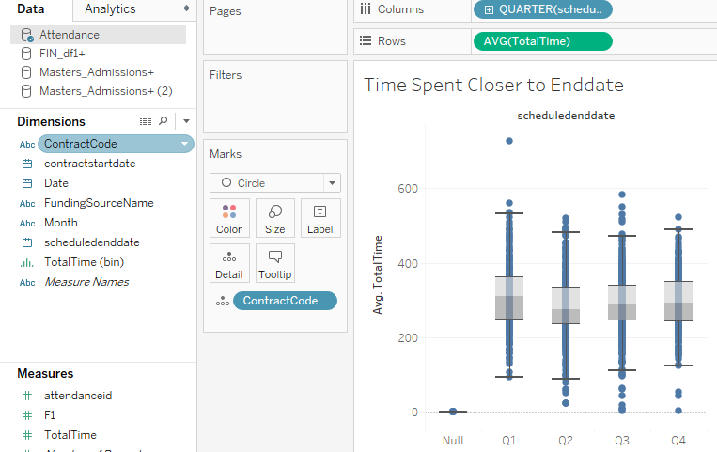
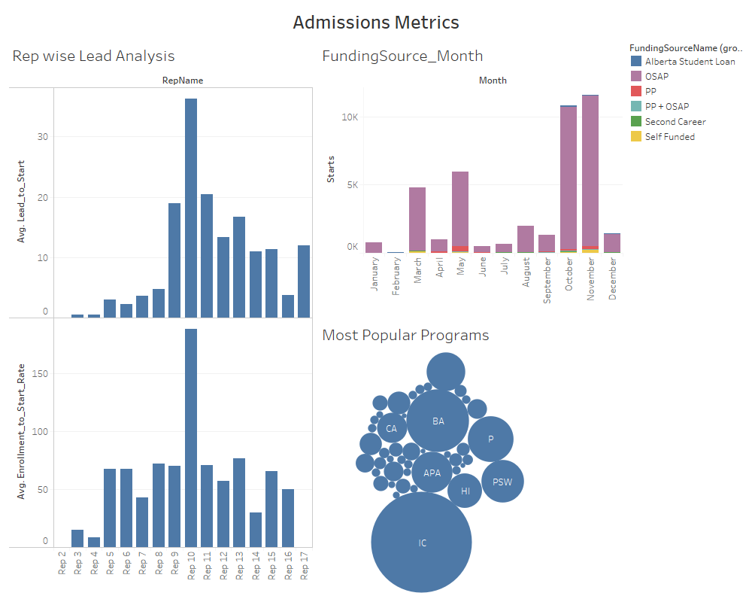
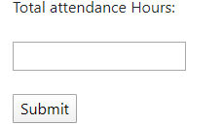
Project Tools
Data Cleaning/Merging
Create a database to store the data
Create a dashboard
Render data from the database to the website/dashboard
Predict student dropouts using ML
Python/
Pandas
Postgres Database
Tableau
HTML
CSS
Bootstrap
Scikit-learn

Slide 6
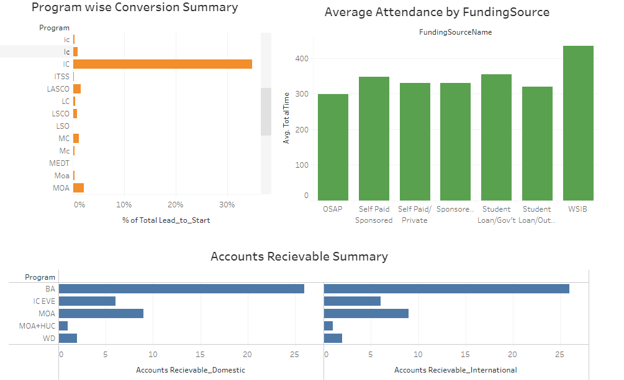
Analysis:
Leads conversion are highest for IC programs
There is a consistency in student attendance across funding sources
BA program has the maximum AR
Note: Personal data has been deidentified

Slide 7
Analysis:
Rep 15 has the maximum conversions
IC followed by BA is the most popular program
Oct and Nov had the maximum OSAP students
Sum of Starts for each Month, the data is filtered on FundingSourceName
Size shows count of ContractCode. The marks are labeled by Program. The view is filtered on Program, which excludes Null.
Average of Lead_to_Start and average of Enrollment_to_Start_Rate for each RepName.
Note: Personal data has been deidentified

Slide 8
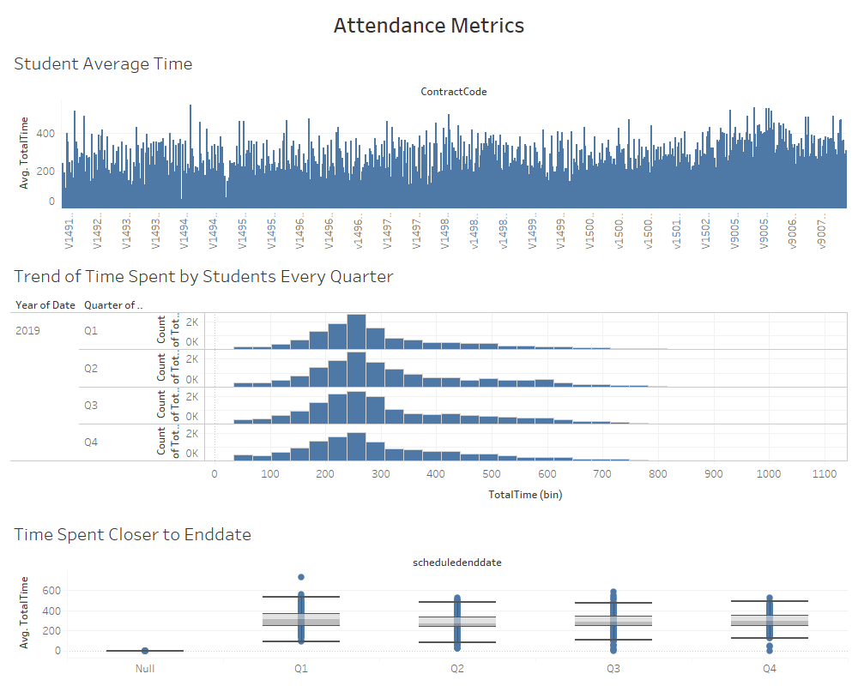
Average of TotalTime for each Student
Analysis:
On an Average time each students spend 200 minutes per sessions
The trend is similar across quarters
Students spend more time closer to the end date of their project
Note: Personal data has been deidentified

Slide 9
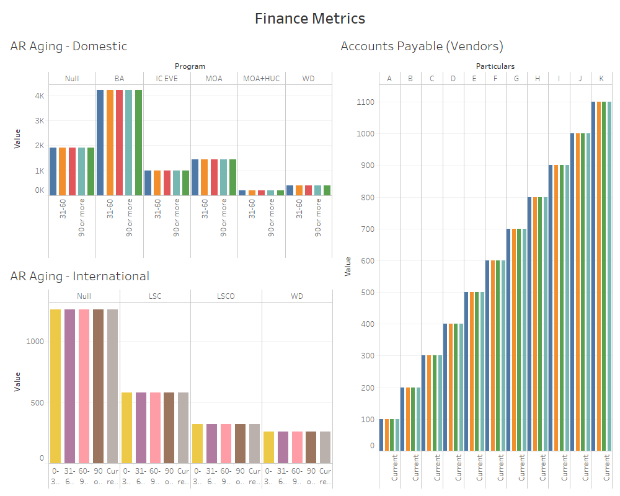
Analysis:
This provides a snapshot of aging across domestic and International students
It also provides summary of aging across programs
Note: For financial metrics dummy data has been used

Slide 10
Thank You!

